Slide 1
Predict Customer Churn

Slide 2
Project overview:
Problem at hand, aim, and objectives.
Dataset description and tools used to explore and analyze the data.
Descriptive statistics.
Inferential statistics.
Recommendations and future steps.
Dataset constraints.

Slide 3
PROBLEM (SMART Approach)
Last year, 16% of all customers were churned, and Management would like a way to find out which customers are most likely to drop off to be able to reach out to them and provide them with better services to retain them.
“How can the Bank minimize loss in revenues caused by credit card churners by 30% through building a model that will help predict which customers are most likely to get churned by next year?”
AIM
Build a model to predict customers attrition accurately using historical data and intervene with necessity actions to minimize attrition and maximize retention.

Slide 4
Dataset
Objectives
Understand the relationship between attrition and continuous and categorical variables:
- Visualize the relationship between attrition and each continuous and categorical variables.
- Find out if the variable is significant in determining customer attrition.
Use logistic regression to build a predictive model to predict churns.
Validate the predictive model.
Use the model score to reach out to customers who are more likely to churn and try to change their decision.
The dataset contains bank customers information and is sourced from Kaggle.
Dataset contains 21 columns, 10127 rows, and no missing values.
CLIENTNUM column is a unique identifier for customers, and our dependent variable is the Attrition Flag column (discrete).
Remaining columns are our categorical and numerical features.
Tools
Tableau.
Jupyter Notebook – Python (Numpy, Pandas, Matplotlib, seaborn, statsmodels.api, sickit-klearn, Sickit-plot, Scipy).

Slide 5
Descriptive Statistics

Slide 6
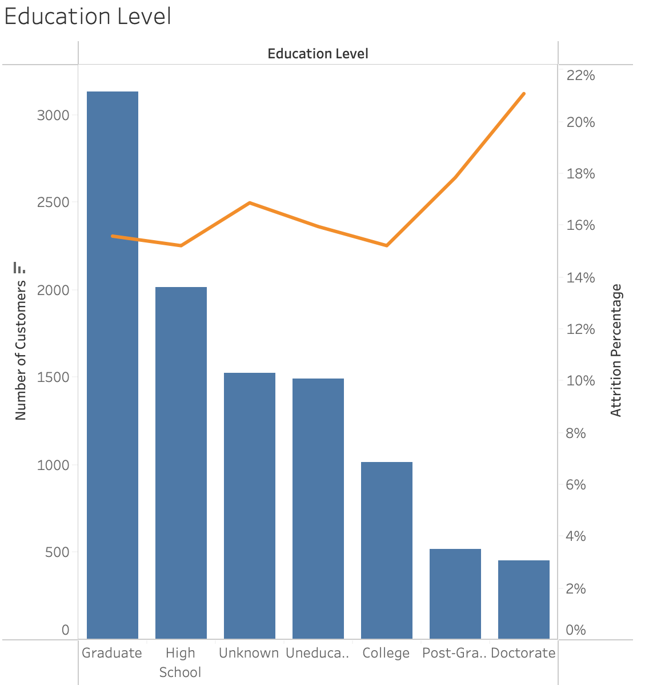
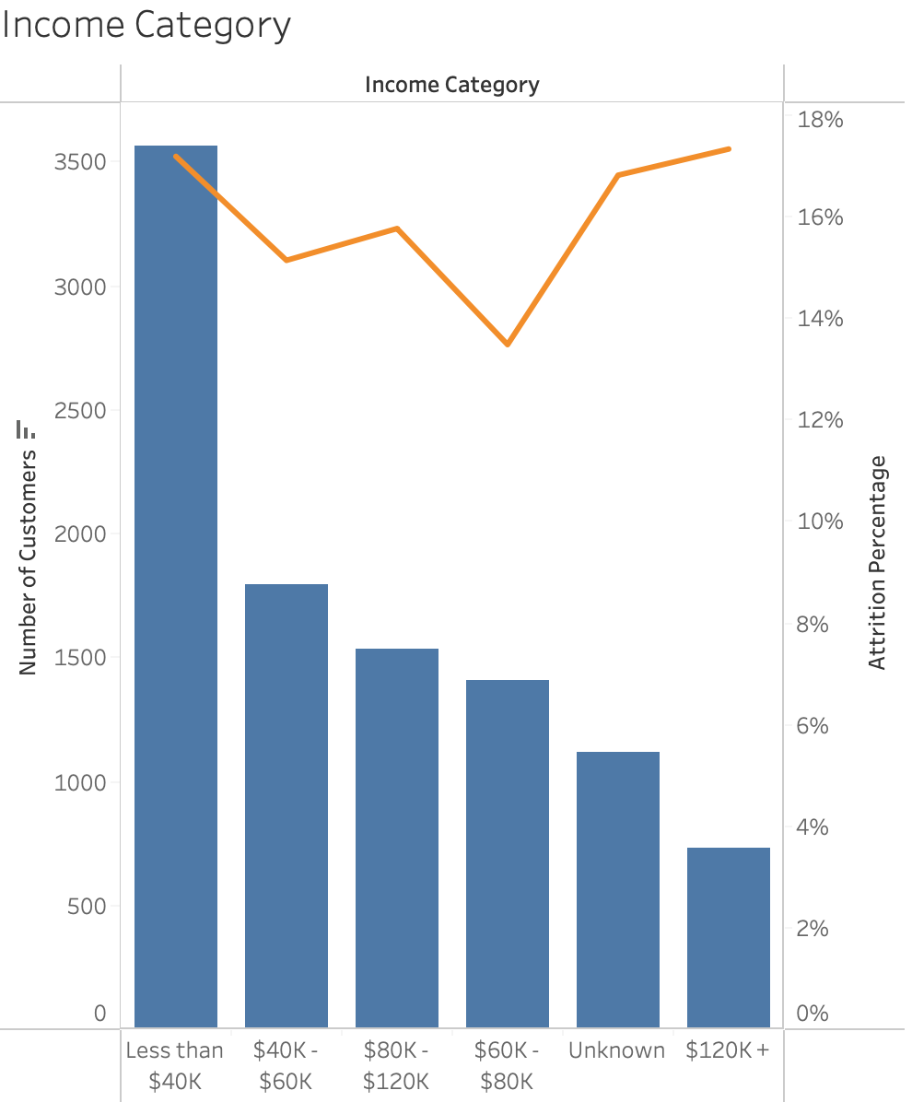
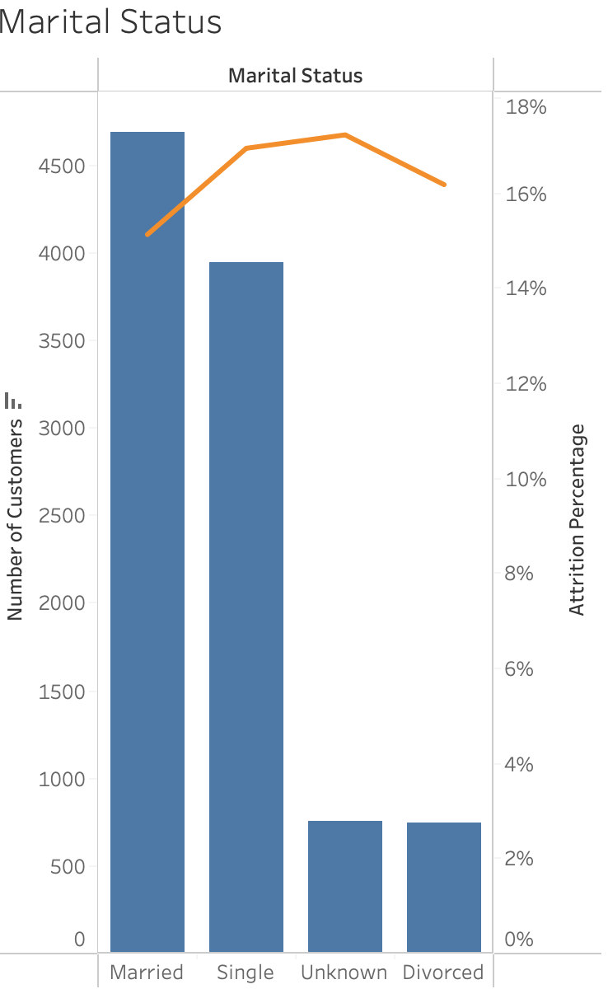
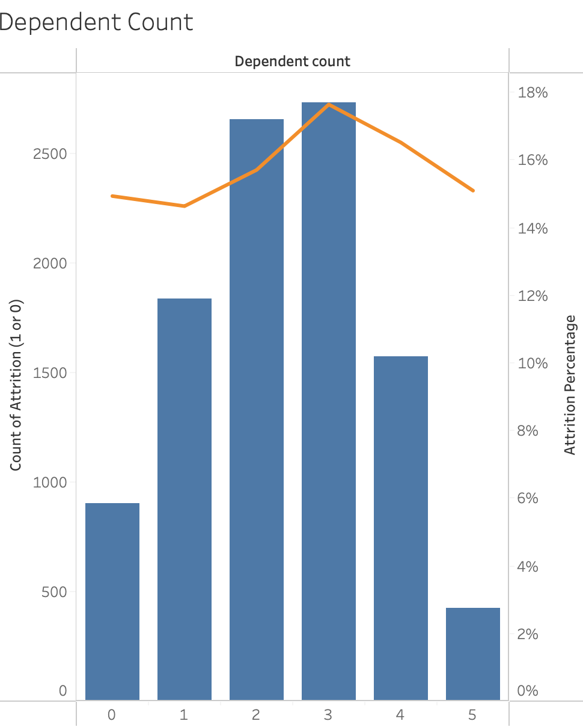
Categorical Variables
Variable | Attrition Percentage
Education Level | Doctorate educated customers the highest attrition % (21%) and represent only (4%) of total customers while Graduate educated have a (16%) attrition %, and represent (31%), indicating that they are more likely to churn.
Income Category | Customers making $120K+ have the same attrition % as those making <$40K (17%), but only represent (7%) of total customers while Customers making <$40K represent (35%), indicating that they are more likely to churn.
Marital Status | Single Customers have a (17%) attrition %, and represent (39%) of total customers, indicating that they are more likely to churn.
Dependent Count | Customers with 3 dependents have the highest attrition % (18%), and represent (27%) of total customers, indicating that they are more likely to churn.

Slide 7
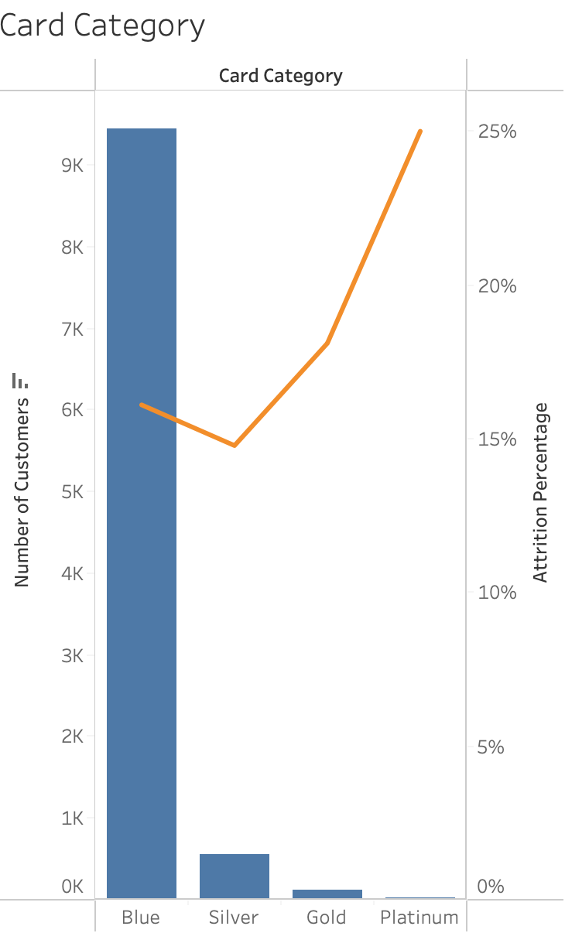
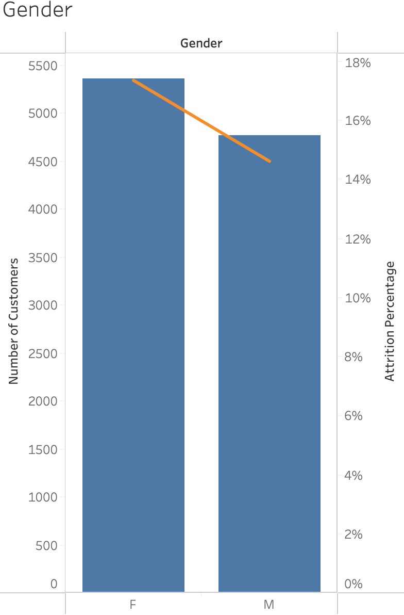
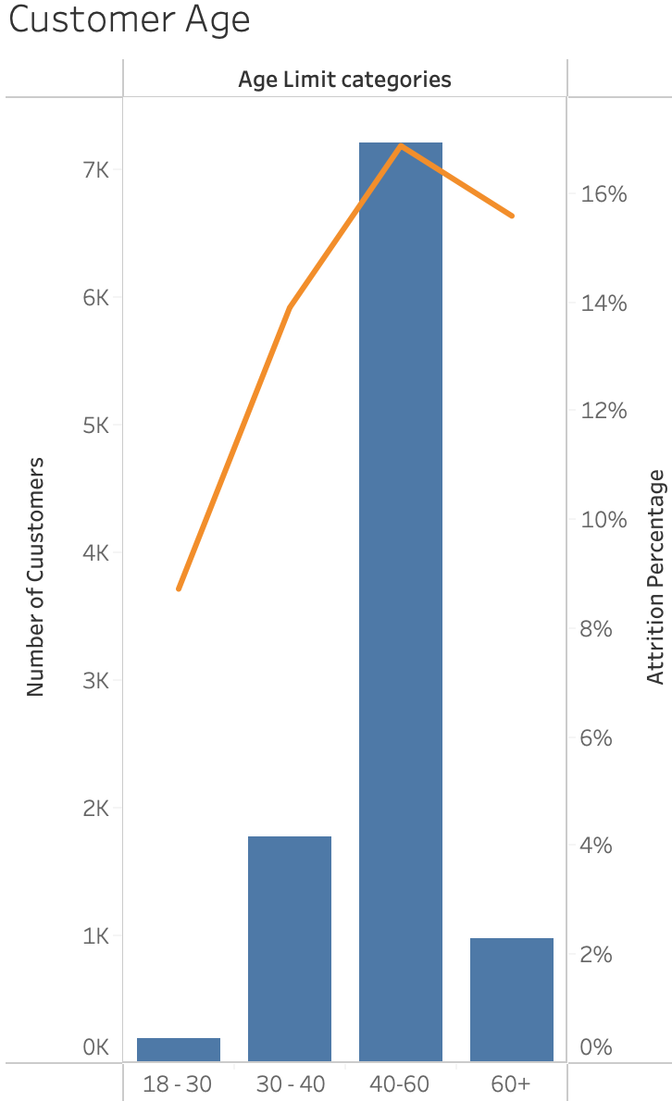
Categorical Variables
Variable | Attrition Percentage
Card Category | Platinum card have the highest attrition % (25%) and represent only (0.19%) of our customer base (20 customers) while Blue card has a (16%) attrition % , and represent (93%), indicating that Blue Card customers are more likely to churn.
Gender | Our female customers have a higher attrition percentage (17%) than our male customers (15%), indicating that female customers are more likely to churn.
Customer Age | Customers aging between 40-60 years old represent (71%) of our customer base and have the highest attrition percentage (17%), indicating that these customers are more likely to churn.

Slide 8
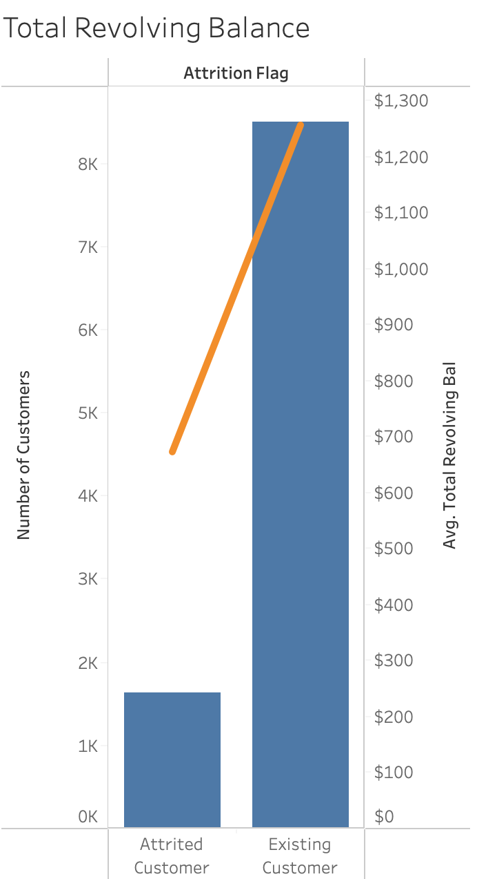
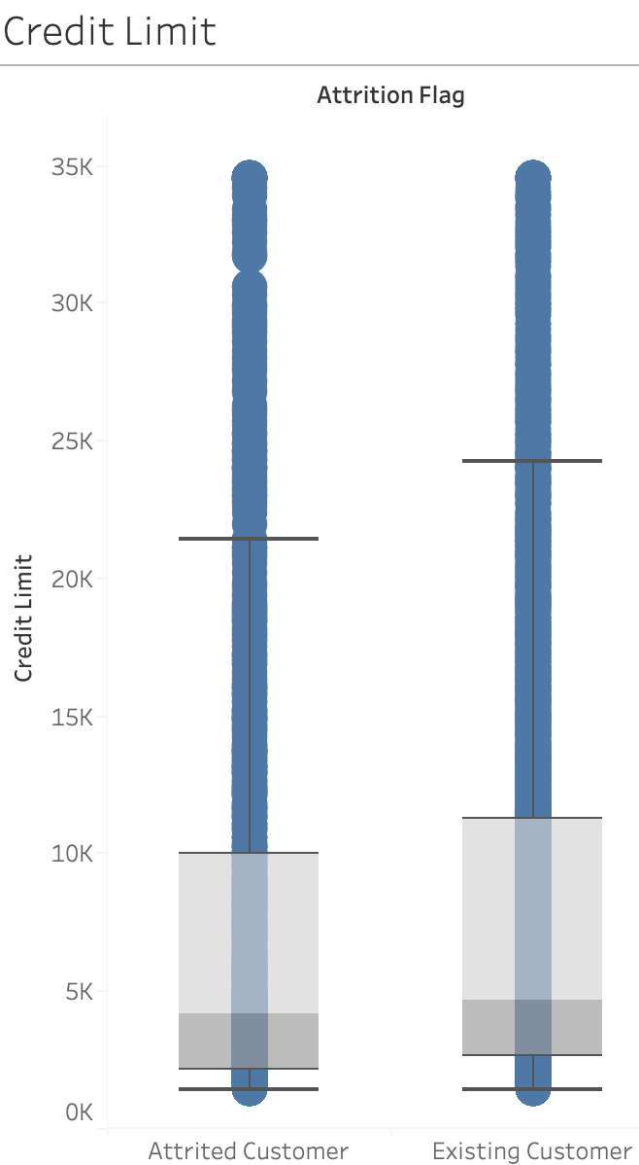
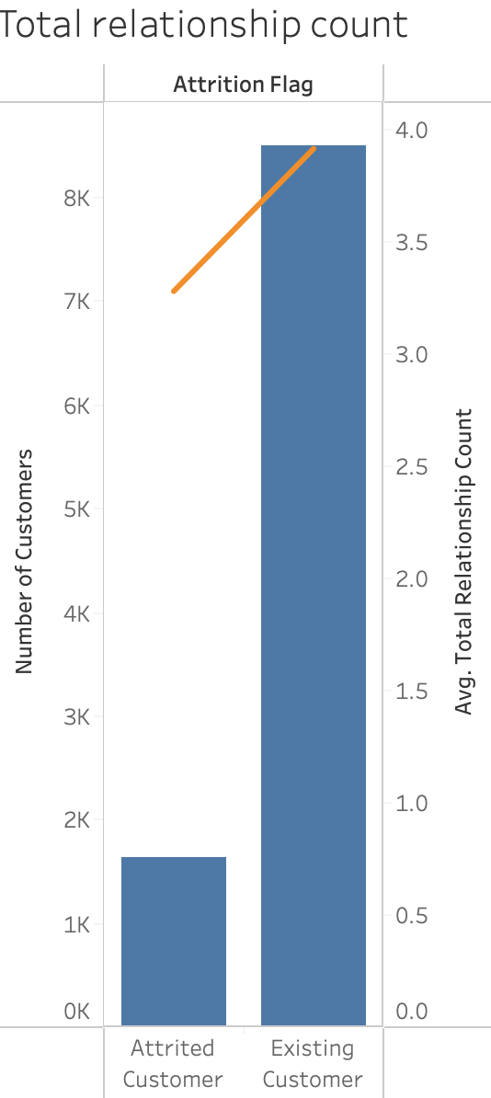
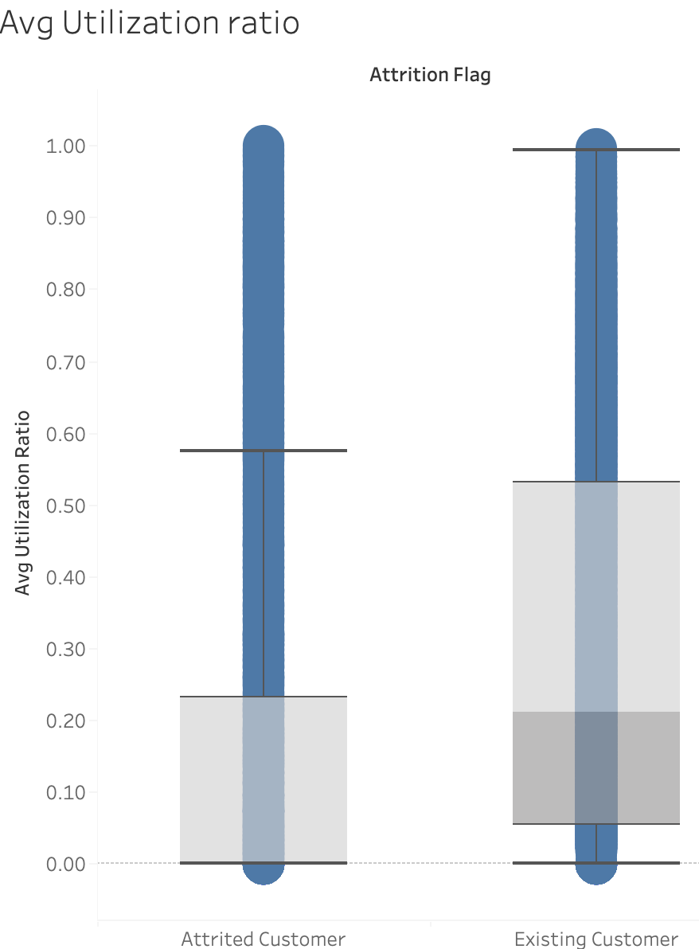
Numerical Variables
Variable | Churned Customers | Existing Customers
Total Revolving Balance | Lower Average total revolving balance ($673) indicating that customers with low revolving balance are more likely to churn. | Higher Average total revolving balance ($1257).
Credit Limit | Lower values for Credit Limit , indicating that customers with lower Credit Limit are more likely to churn. | Higher values for Credit Limit.
Total Relationship Count | Lower average number of products with the bank (3.2), indicating that customers having less products with the bank are more likely to churn. | Higher average number of products with the bank (3.9).
Average Utilization Ratio | Lower values, indicating that customers with lower avg credit utilization ratio are more likely to churn. | Higher values.

Slide 9
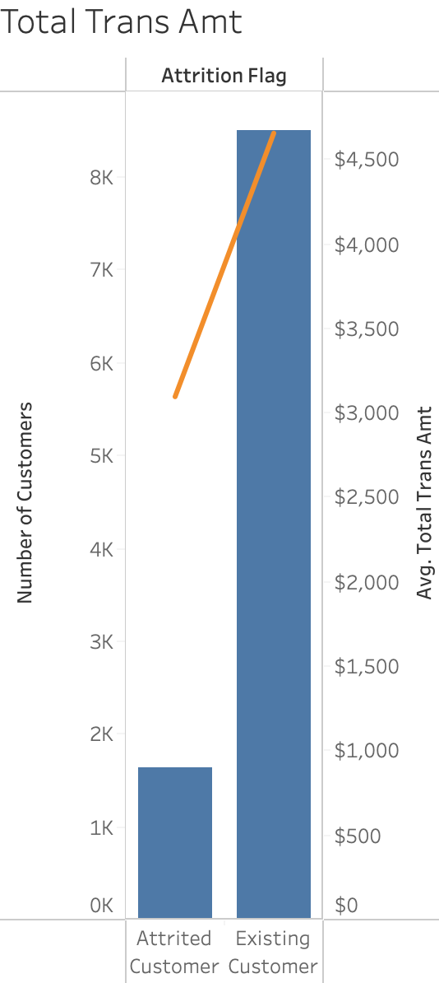
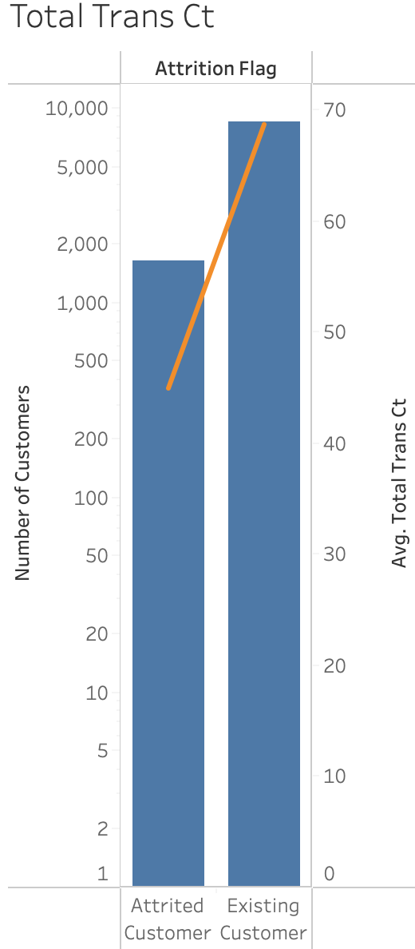
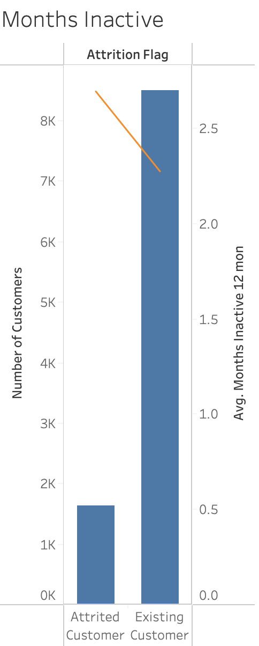
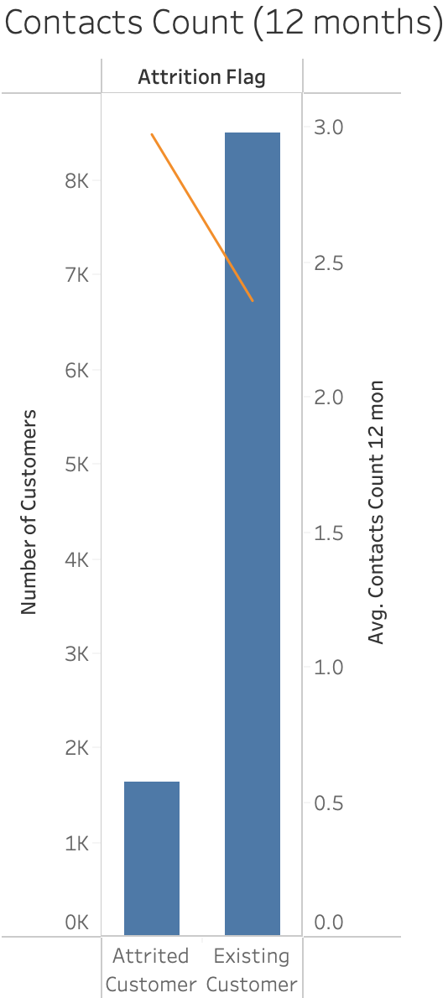
Numerical Variables
Variable | Churned Customers | Existing Customers
Total Transactions Amount | Lower average total transaction amount ($3095), indicating that customers with zero to low transaction amount are more likely to churn. | Higher average total transaction amount ($4655).
Total Transactions Count | Lower average total transaction count (44.9), indicating that customers with none to low transaction counts are more likely to churn. | Higher average total transaction count (68.7).
Inactivity (last 12 months) | Longer average inactivity period (2.7) months, indicating that customers with longer inactivity periods are more likely to churn. | Shorter average inactivity period (2.3) months.
Total Number of Contacts (last 12 months) | Higher average contacts count (2.9), indicating that customers contacting the bank more than others are more likely to churn. | Lower average contacts count (2.3).

Slide 10
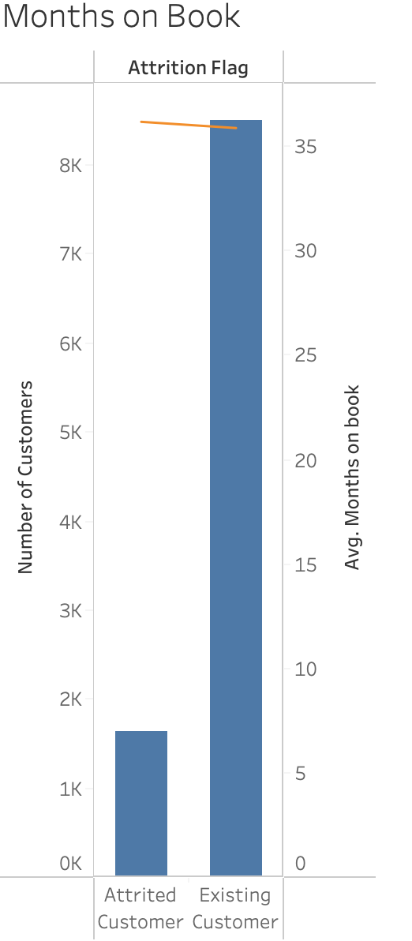
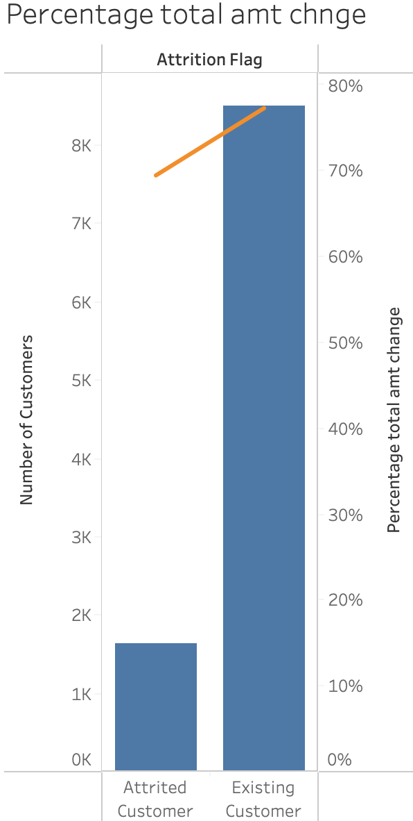
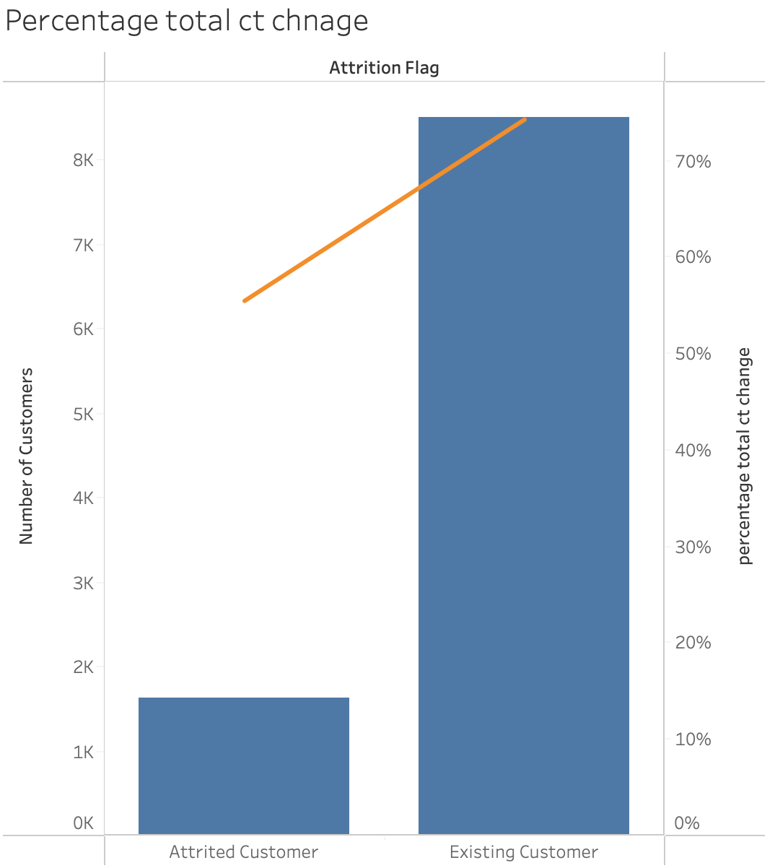
Numerical Variables
Variable | Churned Customers | Existing Customers
Months on book | Longer average relationship with the bank (36.1) months, indicating that customers staying longer with the bank are more likely to churn. | Shorter average relationship with the bank Existing customers (35.8) months.
Total Amount Change (Q1-Q4) | Lower % of total amount change (69%), indicating that customers having none to few changes are more likely to churn. | Higher % of total amount change (77%).
Total Count Change (Q1-Q4) | Lower % of total count change (55%), indicating that customers having none to few changes are more likely to churn. | Higher % of total count change (74%).

Slide 11
Inferential Statistics (T-test, P-value, IV, Logistic Regression)

Slide 12
T-test and P-value
Variable | T stat | P-value
Total revolving balance | 27.4 | < 0.05
Credit limit | 2.4 | < 0.05
Total relationship count | 15.2 | < 0.05
Avg utilization ratio | 18.2 | < 0.05
Total transactions amount | 17.2 | < 0.05
Total transactions count | 40.2 | < 0.05
Total amount change (Q1-Q4) | 13.3 | < 0.05
Total count change (Q1-Q4) | 30.5 | < 0.05
Inactivity (last 12 months) | -15.5 | < 0.05
Total number of contacts (last 12 months) | -21.02 | < 0.05
Using T-test and P-value to determine statistical significance of our Numerical Variables.
Numerical variables mentioned in the right table have P-values < 0.05 and
t- stat > t critical, indicating statistical
significance in determining attritions.
Other Numerical variables were found statistically insignificant
Information Value (IV)
Using IV to determine predictive power of our Categorical Variables.
Income Category has an IV of 0.02, and Education Level has an IV of 0.04, indicating that both variables are weak predictors for attritions.
Other categorical variables were found useless for prediction.
Variable | IV | Predictive Power
Education Level | 0.04 | Weak predictor
Income Category | 0.02 | Weak predictor

Slide 13
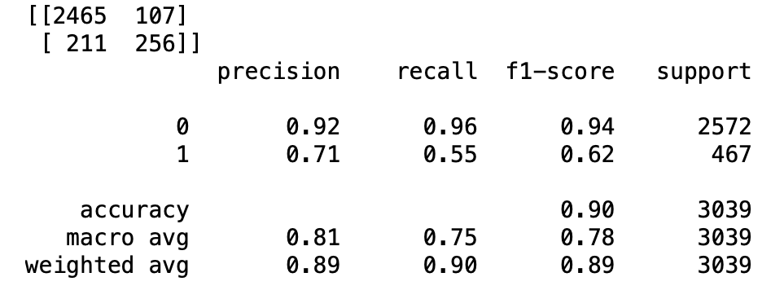
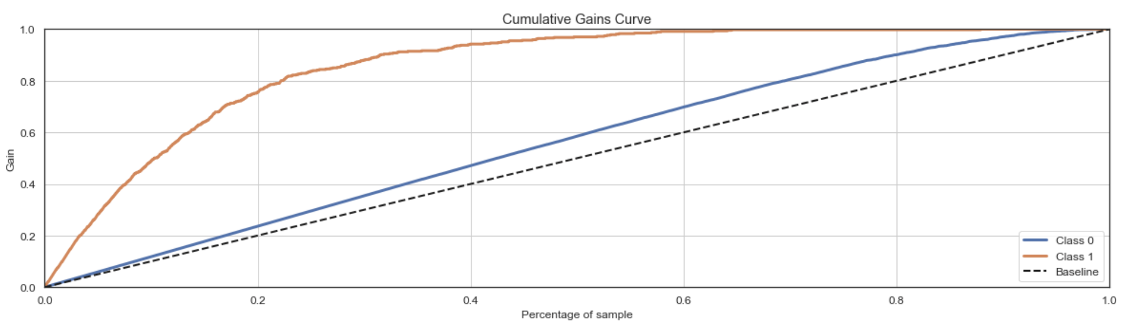
Predictive Model Using Logistic Regression
Confusion Matrix & Classification:
Accuracy of our predictive model is 90%
As you can see the recall for “churn” or “1” appears to be lower at 55%, as in this case the model has chosen a particular cutoff.
We could ideally look at the gains chart to arrive at an optimal cutoff and classify churn vs. non-churn.
Value of Predictive Model
If we approached 20% of our customer base, we would be able to recall 20% of customers attrition, but if we reach out to top 20% of customers using model score, we would be able to recall almost 80% of actual attritions improving the marketing ROI by 3 times.

Slide 14
Recommendations
Focus our marketing efforts on customers who are more likely to churn according to the predictive model scores.
Speak with customer service to understand the complaints of clients who contacts the bank frequently then get churned.
Focus on our blue card and enhance the card features and integrate rewards programs.
Study our platinum card to decide whether we should keep it or cancel it, considering it only serves 20 customers, which 5 of them were churned.
Make sure we have all the data and information needed on customers – using required fields to have better integrity and avoid unknown values.
Future Directions
Make sure we have the dates for joining the bank as well as exiting – for better monitoring of churning.
Make sure we have all information needed for every customer’s profile – mark fields as required for better data integrity and accuracy.

Slide 15
Dataset Limitations and Constraints
We have only 16% of customers who have churned, making it difficult to train our model to predict churning customers.
Data is based on only past 12 months, making it difficult to:
- Look at trends and seasonality of attrition.
- Compare and monitor changes in attrition.
The dataset contained many “unknown” values, which we had to replace using the mode of values.
The Churning Customer Profile
A customer who more likely has a graduate degree.
A customer with no to few changes in:
- Total amount change (Q1-Q4). - Total count change (Q1-Q4)
A customer with lower:
- Average credit utilization ratio - Average Total relationship count
- income <40K - Credit Limit
- Average Total revolving balance. - Average Total transactions count
- Average Total transactions amount
A customer with:
- Higher Average Contacts count. (Last 12 months)
- Longer Average Inactivity period. (Last 12 months)

